Slide 1
Probation Continuum of Care Reform Claiming, Funding, and Reconciliation California Department of Social Services
Notes:
Hello and welcome to the Title IV-E CDSS fiscal claiming training. This training is based on the updated instructions developed in conjunction with CPOC and approved by the Administration for Children and Families, otherwise known as ACF.
We appreciate your partnership as we have worked through this process for the last year and welcome any feedback or questions that you might have. If there are any questions we are unable to answer today, we will be sure to transmit information through Rosie in the next few weeks.
Please hold any questions. As we go through the presentation, questions may be answered and there will be time for questions at the end.

Slide 2
Objectives
Probation Title IV-E claiming
Funding
Continuum of Care Reform (CCR) Claiming and Reconciliation

Slide 3
Continuum of Care Reform Claiming and Funding
C

Slide 4
CCR Goals
Reducing the usage of congregate care placement settings by moving to Home-Based settings.
Increasing the use of home-based family care
Restructured the previous age-based rate system to a Level of Care rate system based on an assessment of the child’s need.

Slide 5
Administrative Components of CCR
Subject | All County Letter (ACL) | County Fiscal Letter (CFL)
Foster Parent Recruitment, Retention and Support (FPRRS) | ACL No. 15-76 ACL No. 15-88 | CFL No. 15/16- 48
Child and Family Team (CFT) | ACL No. 16-84 | CFL No. 16/17-22 CFL No. 17/18-09 CFL No. 17/18-09E
Resource Family Approval (RFA) | ACL No. 16-10 ACL No. 16-58 | CFL No. 15/16-65
Second Level Administrative Reviews | ACL No. 17-122 | CFL No. 16/17-71
CCR Home Based Family Care Rate Structure (Phase I) | ACL No. 16-79 | CFL No. 16/17-41 CFL No. 16/17-41E CFL No.16/17-41EII
CCR Home Based Family Care Rate Structure (Phase II) | ACL No. 17-11 | CFL No. 17/18-32 CFL No. 17/18-32E

Slide 6
Foster Parent Recruitment, Retention and Support (FPRRS)
Funding available for County Probation Departments (CPD) to invest in activities to recruit and retain the number of foster parents, relative caregivers and resource families available for placement of court dependent minors or non-minor dependents (NMDs).
Program Codes:
PC 939 – Probation FPRRS Federal
PC 940 – Probation FPRRS Training Federal
PC 941 – Probation FPRRS Non-Federal
PC 943 – Probation FPRRS Foster Parent Training Federal

Slide 7
FPPRS Allocation
FPPRS | FY 2015-16 | FY 2016-17 | FY 2017-18
Allocation | $17.2m (CWD and CPD) $721,549 (participating CPDs) | $43.2m (CWD and CPD) $15.5m (participating CPDs) Includes: $5m to LA $10.5m based on % of RCL costs Unspent funds from FY 2015-16 | $43.2m (CWD and CPD) $15.5m (participating CPDs) Includes: $5m to LA $10.5m based on % of RCL costs Unspent funds from FY 2016-17*
Notes | Unspent funds rolled over to FY 2016-17 | Unspent funds rolled over to FY 2017-18 | *Authority exists; CDSS working with CPOC to operationalize; CFL pending.
FY 2015-16: CFL 15/16-58
FY 2016-17: ACL 16-52 FY 2017-18: CFL 17/18-37
Notes:
Details
Allocation made was in consultation with Chief Probation Officers of California. A total of $15.5M was distributed to those probation departments participating in FPPRS based on the following:
Planning allocation of $5M to LA County Probation due to size of county
$10.5M distributed based on a percentage of each county’s cost related to the Rate Classification Level (RCL) 1 through 14. The RCL costs were calculated based on a point in time of each county’s caseload census of youth in group homes (in-state and out-of-state) as of January 1, 2017, and then multiplied by the tiered payment rate for RCLs.
A minimum floor of $15,700 was incorporated for each county
Budget Act of 2016 included reappropriation authority language which made any FY 15/16 unspent funds available in FY 16/17 (ACL 16-52)
54 counties submitted FPPRS plans and were awarded funds. This included 11 plans submitted jointly by a county’s CWD and CPD, and 12 plans submitted independently by CPDs.
FY 16/17 Allocation – ACL 16-52 and CFL 16/17-34, Based on Budget Act 2016
Allocation amounts for non-participating counties were redistributed to participating counties (CFL 16/17-34)
Award letters were not issued because unlike FY 15/16, the amount of FPPRS funding to be allocated was predetermined using a fixed allocation methodology, and was not dependent upon the content of a department’s FPPRS plan. (Per L. Hall email dated 10/11/16)
Per W&IC section 16003.5(b), all CWDs and CPDs requesting funding for FY 16/17 must have submitted an application by September 1, 2016
The Outcome report for FY 16/17 was due September 30, 2017. CDSS utilized an online survey, Survey Monkey to collect FPPRS reports from counties
If probation departments gave a portion of their allocation to child welfare departments, must have noticed DSS of the amount.
Child welfare departments’ and probation departments’ allocation funds will be tracked separately and will not be comingled (CFL 17/18-37 p. 2)
Question: Can FPRRS be rolled over?
Answer: Authority exists and the details are being discussed with CWDA and CPOC. It is anticipated that unspent funds from FY 2016-17 will be reappropriated to FY 2017‑18 on a county specific basis. CDSS is currently deciding on the framework of reappropriation.
Duration: 2 minutes

Slide 8
Child and Family Teams (CFT)
A CFT is a group of individuals that includes the child or youth, family members, professionals, natural community support and other individuals identified by the family who are invested in the child, youth and family’s success.
Program Codes:
PC 947 – Probation CFT Federal
PC 948 – Probation CFT Non-Federal
PC 955 – Child and Family Team (CFT) Detention - Probation Non-Federal

Slide 9
CFT Allocation
CFT | FY 2015-16 | FY 2016-17 | FY 2017-18
Allocation | -- | $22m (CWD and CPD) $1.6m CPDs | $51.1m (CWD and CPD) $5.6m CPDs Unspent funds from FY 2016-17*
Notes |  | Funds were distributed based on a percent to total of the average point-in-time FY 2015-16 Child Welfare Services Foster Care cases as reported on the CA Child Welfare Indicators Project. Unspent funds rolled over to FY 17-18 | The FY 2017-18 GF allocations for the counties participating in the Title IV-E California Well-Being Project will be included in a forthcoming Title IV-E California Well-Being Project final allocation CFL, but are also displayed in CFL 17/18-42 *Authority exists; CDSS working with CPOC to operationalize; CFL pending.
FY 2016-17: CFL 16/17-24
FY 2017-18: CFL 17/18-42
Notes:
Details
FY 16/17 Allocation – CFL 16/17-24
$20.4M – Child Welfare Departments
$1.6M – Probation Departments based on the following:
Funds were distributed based on a percent to total of the average point-in-time FY 2015-16 Child Welfare Services Foster Care cases as reported on the CA Child Welfare Indicators Project (CCWIP).
A minimum floor of $5,500 was incorporated for each county. Counties receiving an allocation above $40,000 will fund the minimum floor on a percent-to-total basis.
FY 17/18 Allocation – CFL 17/18-42 – Methodology remains the same as used in FY 16/17
$45.5M – Child Welfare Departments
$5.6M – Probation Departments based on the following:
The FY 2017-18 GF allocations for the counties participating in the Title IV-E California Well-Being Project will be included in a forthcoming Title IV-E California Well-Being Project final allocation CFL, but are also displayed in CFL 17/18-42
Question: Can CFT be rolled over?
Answer: Answer: This is still being discussed with CWDA and CPOC. It is anticipated that unspent funds from FY 2016-17 will be reappropriated to FY 2017 18 on a county specific basis. CDSS is currently deciding on the framework of reappropriation.
Duration: 4 minutes

Slide 10
Resource Family Approval (RFA)
RFA improves the way caregivers (relative and non-relative) are approved by prepping families to better meet the needs of vulnerable children, youth and NMDs in the county child welfare and/or probation systems. The RFA replaces multiple existing processes of licensing or certifying foster homes, approving relatives, non-relative extended family members (NREFMs), prospective adoptive parents and legal guardians.
Program Code:
PC 889 – RFA Probation Federal
PC 897 – RFA Probation Non-Federal

Slide 11
RFA Allocation
RFA | FY 2015-16 | FY 2016-17 | FY 2017-18
Allocation | -- | Allocation provided to CWD Total non-federal costs = $14.3m Of which $6.3m was offset by subsumed activities within the 2011 Realignment base funding $8m in GF Unspent funds rolled over to FY 17-18 | $27.9m (CWD and CPD) $10.6m* subsumed activities $1.2m CPDs Based on budget assumption for FFA conversion with minimum floors: Very small counties = $3,000 Small counties = $3,000 Medium counties = $10,000 Unspent funds from FY 2016-17**
Notes |  |  | *$10.6m associated with licensing activities related to RFA were realigned for CWDs **Authority exists; CDSS working with CPOC to operationalize; CFL pending.
CFL 17/18-47
Notes:
Details
CFL 17/18-47 AB403 requires that all currently licensed foster family homes, approved relative caregivers, an non-related extended family members (NREFM) must convert to RFA no later than December 31, 2019. State law also requires that these caregivers receive notification from counties of these requirements, that families have an approved adoption home study prior to January 1, 2018, and for some other families, to have a psychosocial assessment of the family.
In consultation with CPOC, the distribution of the $1.2 million is based on the budget assumptions for FFA conversion, New RFA Homes, Due Process, Administrative Notices, Registered Sex Offender checks, Adam Walsh out of state background checks, Complaints and Annual RFA updates. To ensure there is an adequate level of funding to support new implementation activities required under the RFA program for very small, small, and medium size counties, the distribution includes the following floors:
$3,000 Very small AND small counties
$10,000 Medium Counties
The RFA allocation is subject to the application of the Federal discount rate for Child Welfare Departments.
ACL 16-58
· FY 16/17 total non-federal costs approximately $14.3m which represented 6 months of funding ‘
· From the $14.3m, $6.3m was offset by subsumed activities within the 2011 Realignment base funding
o Subsumed activities included: Annual and Multiple Relative Home Approvals, Adoptions Approvals and Adoptions Background Check
· Resulted in $8m in General Fund for RFA
Question: Can RFA funds be rolled over?
Answer: RFA funds can rollover. Each departments amount should just rollover into the next year.
Duration: 2 minutes

Slide 12
RFA
The CPDs may use PC 130 (PROBATION IV-E/TRAINING) to claim enhanced rate RFA-related staff development activity costs.
See CFL No.15/16-65 for more information.

Slide 13
Second Level Administrative Reviews
Second level administrative review approval requirements for children of any age, including Non-Minor Dependents (NMD) in group homes and Short-Term Residential Therapeutic Programs (STRTP) authorized through AB 403 and AB 1997 effective January 1, 2017.
Extension approval must be approved by the County Welfare Department Director/Deputy Director or CPD Chief Probation Officer or his/her designee. Probation cases must be re-evaluated every 12 months.
Costs captured in the PC 127 (Probation Case Management) will automatically shift in the County Expense Claim.

Slide 14
Second Level Review Allocation
Second Level Review | FY 2015-16 | FY 2016-17 | FY 2017-18
Allocation | -- | $23,000 (CWDs and CPDs) $8,000 CPDs | $23,000 (CWDs and CPDs) $8,000 CPDs Unspent funds from FY 2016-17*
Notes |  | Funds were distributed based on FY 2015-16 group home caseload percentages, by county, from California Child Welfare Indicators Project. Minimum floor of $85 applied to each county. Counties with funding over $150 were adjusted to help meet the minimum floor. Unspent funds rolled over to FY 2017-18 | *Authority exists; CDSS working with CPOC to operationalize; CFL pending.
CFL 16/17-51
Notes:
Details
$23,000 allocated based on the following methodology for child welfare and probation agencies in the Budget Act of 2016
Question: Can Second Level Review funding be rolled over?
Answer: This is still being discussed with CWDA and CPOC. It is anticipated that unspent funds from FY 2016-17 will be reappropriated to FY 2017-18 on a county specific basis. CDSS is currently deciding on the framework of reappropriation.
Duration: 2 minutes

Slide 15
CCR Reconciliation
What does this mean for Probation?
Framework of Funding
Data Collection
Tracking of Cases
Determination of Probation Savings

Slide 16
Framework of Funding and Reconciliation
With the implementation of CCR, CDSS provided an upfront investment via assistance and administrative cost:
Level of Care Rate System
FPRRS, CFT, RFA, 2nd Level Admin Review
Assistance savings will be generated through the stepdown of expensive GH placements to less expensive lower levels of care.
CDSS will reconcile the assistance savings with the upfront CCR administrative investments with the goal of reducing future investments. The Department will begin to reconcile FY 16-17 in the Fall of 2018.

Slide 17
Framework of Funding
CDSS will look at the caseload movement post CCR.
In assistance, a pre-CCR cost per case was developed for each program (FC. AAP, Kin-GAP etc.). A by county analysis will be conducted on a post-CCR cost per case for each program.
Any change from the pre-CCR cost per case will be the net result of the increase due to the Home-Based Family Care rate, offset by a reduction in cost from the step down of higher cost group home cases to lower levels of care.

Slide 18
Reconciliation Process
CCR administrative costs will be monitored on a quarterly basis through the budgeting process and CDSS will make budget adjustment based on actual claims.
Any savings from the GH stepdown will be used to offset future CCR administrative funding for each county.

Slide 19
Reconciliation Process Continued
Program costs that remain due to lack of reinvestment funds from cases moving out of congregate care will continue to be funded.
Expenditures that exceed the statewide amount allocated for the services programs will be considered during the budgeting process.

Slide 20
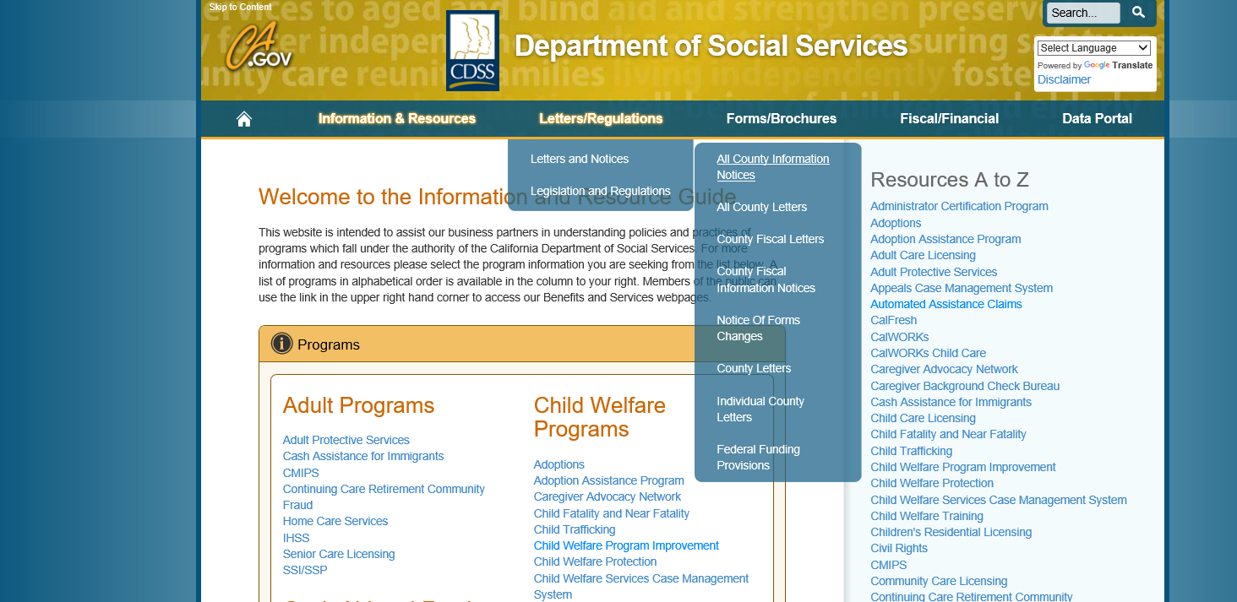
CDSS Website
www.cdss.ca.gov/inforesources

Slide 21
Questions or Concerns?
Fiscal/Claiming: Fiscal.Systems@dss.ca.gov
RFA Program: RFA@dss.ca.gov
CFT Program: CWSCoordination@dss.ca.gov
General CCR: CCR@dss.ca.gov

