Slide 1
Fresno County Probation Adult Compliance Team “ACT”
Building Collaborations Presentation for
Chief Probation Officers of California
March 2013

Slide 2
Multi-Agency Adult Compliance Team (ACT)
The ACT team was implemented with the belief that Intensive supervision based on offender assessment enjoined with evidence based practices would form the cornerstone of the Fresno County AB 109 supervision model. ACT officers are part of the intensive supervision model.
The intensive approach is seen in the formation of ACT;
An interagency public safety alliance with local law enforcement agencies and county justice partners that provides an additional level of offender accountability and public safety.
The team consists of officers from the Fresno County Probation Department, the Fresno Police Department, the Clovis Police Department , the Fresno County District Attorney’s Office; lead by a Fresno County Deputy Sheriff’s Sergeant
The “strike team” concept is used to describe peace officers under ACT, dedicated to particular enforcement and public safety purposes, with an immediate capacity to take action with offenders under probation supervision, post release community supervision (PRCS), and mandatory supervised release by the Fresno County Probation Department

Slide 3
MISSION
The mission of ACT is to provide an additional layer of offender supervision to ensure offender accountability, surveillance, and supervision through mobile, intensive and evidence based practices leading to enhanced public safety and offender compliance.

Slide 4
GOALS
To reduce the occurrence of new criminal acts by targeting offenders on probation, post release community supervision, and mandatory supervised release with intensive surveillance by peace officers dedicated to enforcement of conditions of release.
To identify supervised offenders who are not meeting their conditions of release in order to ensure compliance.
To mitigate the need for custodial sanctions through appropriate early interventions.
To gather, collect, and provide information and direction regarding the post release community supervision (PRCS) and realignment populations for all law enforcement agencies in the County of Fresno and act as the point of contact for dissemination of offender information to law enforcement.
To respond rapidly to emergency situations with knowledge and information about the offenders.
To provide other public safety responses including searches as authorized by the terms of release and warrant services, as needed.

Slide 5
About one third (32.7%) of the PRCS population have ACT contacts. ACT contacts can be initiated by the ACT or at the request of the Deputy Probation Officer.
October 2011 – September 30, 12
ACT Initiated | Number | Percentage
Attempt to Contact | 261 | 23%
Compliance Checks | 204 | 20.6%
Residence Verification | 141 | 14.2%
Self-Initiated Activities | 102 | 10.3%
Arrest(s) | 67 | 6.8%
Assist Other Agency | 47 | 4.7%
Attempt Warrant | 32 | 3.2%
Warrant Service | 21 | 2.1%
Mitigating incarceration contact | 15 | 1.5%
Others | 101 | 10.3%
Total | 991 | 100.0%
DPO Initiated | Number | Percentage
Attempt to Contact | 322 | 31.5%
Residence Verification | 203 | 19.8%
Compliance Checks | 106 | 10.4%
Arrest(s) | 100 | 9.8%
Attempt to Flash Incarcerate | 63 | 6.1%
Attempt to Revoke | 56 | 5.5%
Mitigating Incarceration contact | 56 | 5.5%
Notify Appointment | 37 | 3.6%
Business Card Left | 30 | 2.9%
Others | 50 | 4.9%
Total | 1,023 | 100.0%

Slide 6
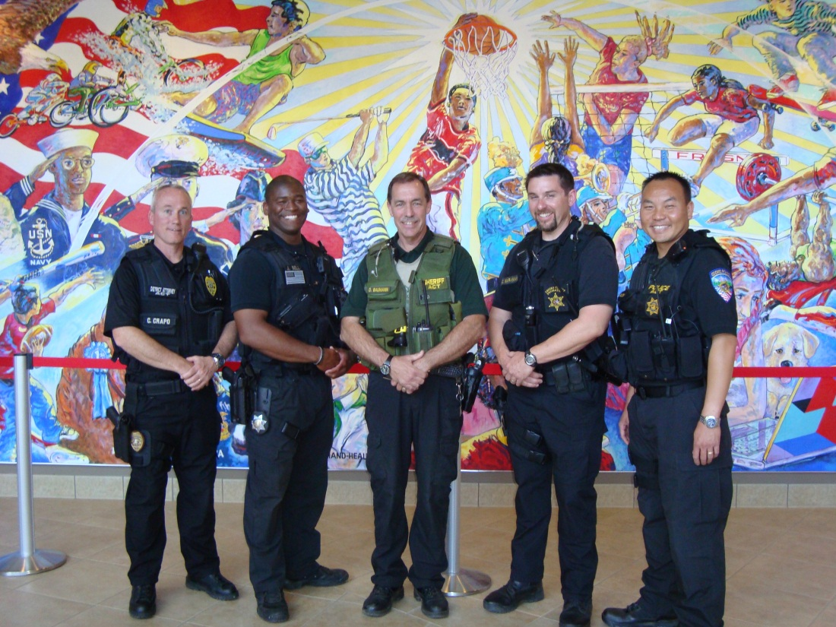
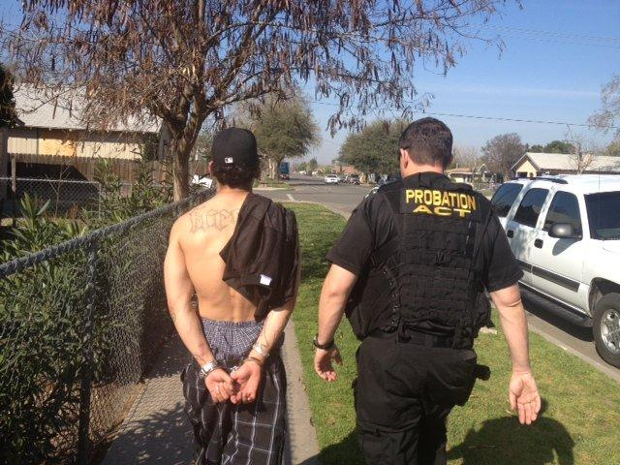
“What is unique about this job is one minute you are transporting an offender to treatment and the next involved in a high level tactical enforcement activity”…DPO
“We are always looking for more tools to deal with this population”…FPD Officer
“While at a restaurant the team was approached by a PRCS offender whom we had arrested who thanked the team for their help…he stated he was going to do better and make changes in his life”…ACT Sergeant

Slide 7
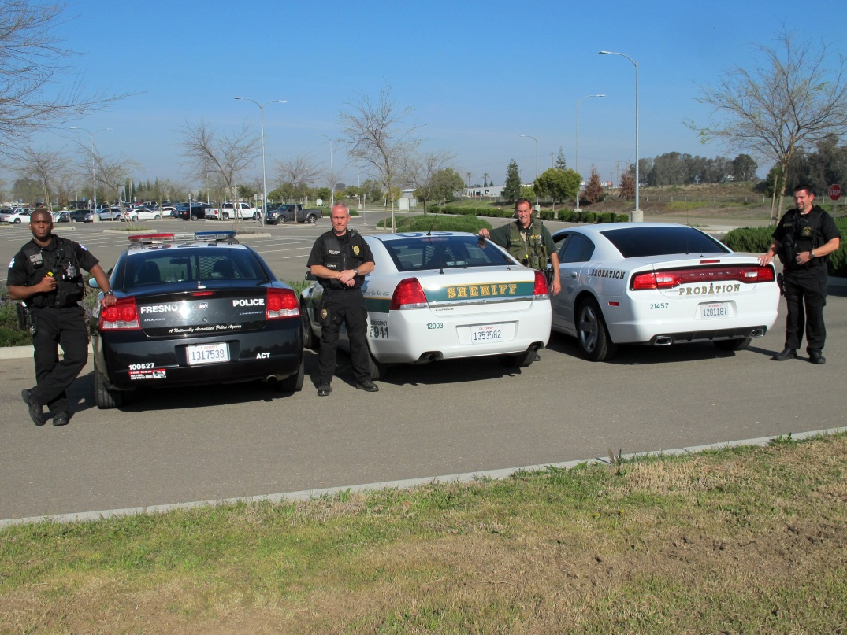
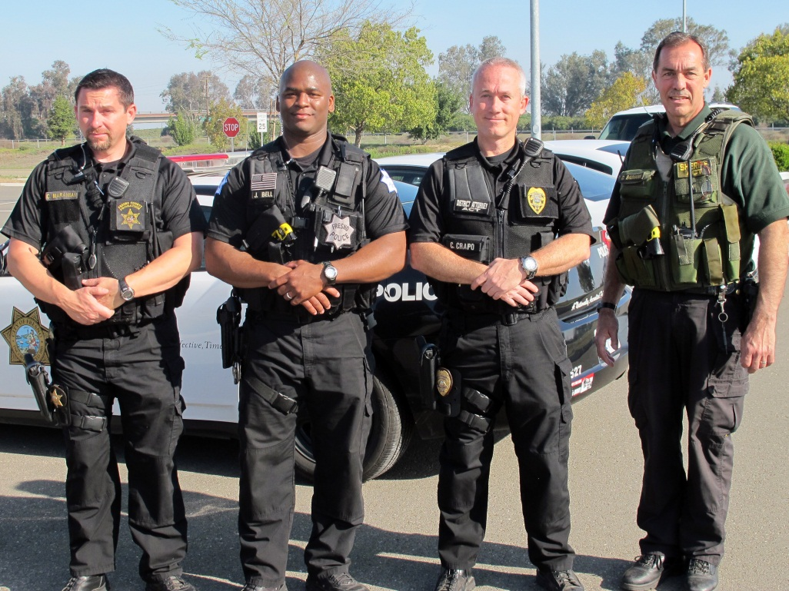

Slide 8
Contact Information
Justin Bell
(559) 349-1691
Wa Cha
(559) 694-5118
Clark Crapo
(559) 283-2854
Chris Maranian
(559) 352-7744
Sgt. Dale Baumann
(559) 974-3436

