Slide 1
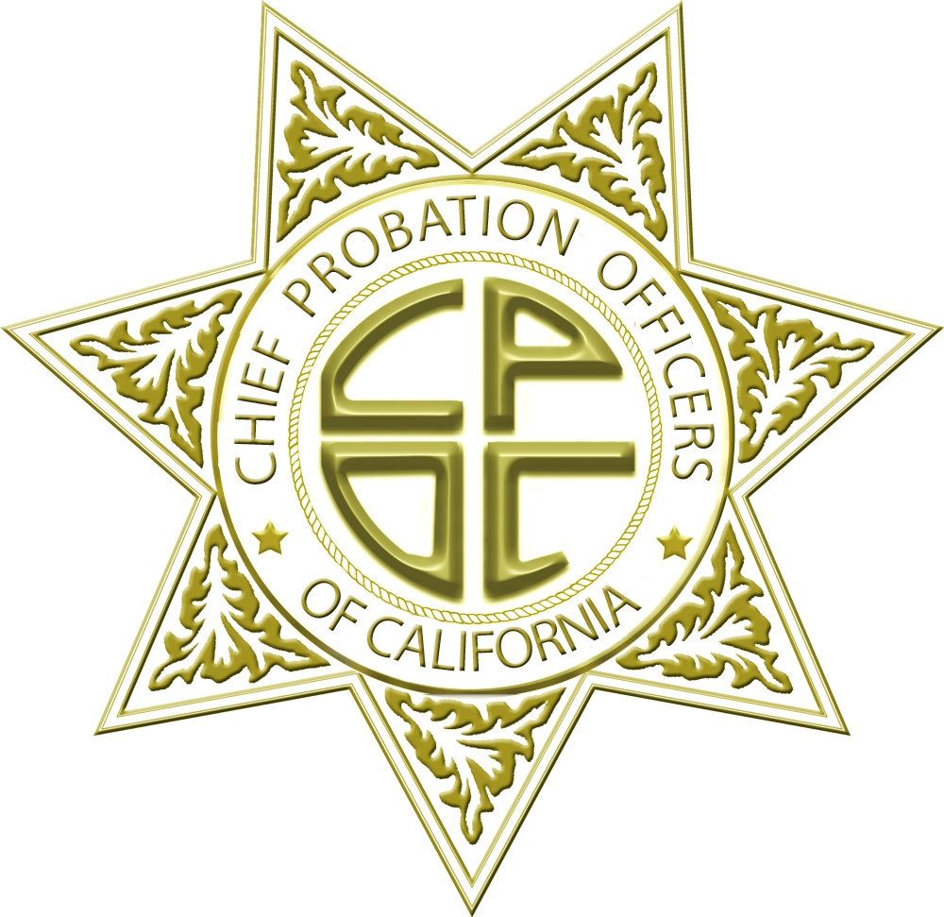

Slide 2
SB678
Chief Mack Jenkins, San Diego

Slide 3
This was created over the last 5 years through important legislation
2011:
AB109 and AB118 Realignment
2011: SB678 Funds
2010:
AB1 Seed Money
2009: SB678 AB1 Pass

Slide 4
Prison population change over time

Slide 5
Decline in Probation Revocations to State Prison
23% Decline

Slide 6
$220 million over the first 2 years was reinvested in strategies proven to lower recidivism
Risk/Need Tools
Smaller Caseloads
Targeted intervention for High Risk Offenders
These tools and funding allowed Probation to deal with the new Realignment population successfully

Slide 7
In 2012, money may not be available if SB678 is reduced
Jan Budget

Slide 8
Probation Data Overview
Chief Michael Daly, Marin
Kevin O’Connell
Notes:
m

Slide 9
Adult probation supervises 350,000 convicted felons

Slide 10
There are 40,000 offenders being supervised under realignment

Slide 11
Underuse of split sentences mean 75% of Local Prison terms will leave incarceration with no re-entry plan

Slide 12
Diversity in sentencing practices has result in varying levels of policy implementation
Darker Green Counties have higher levels of split sentencing

Slide 13
Actual Local prison terms were above original estimates by 20%

Slide 14
Early Outcome Measurement
Warrants and Failures to Appear
7% of PRCS failed to Appear
8% are on active warrants
Recidivism Definition:
At the closure of the supervision term, was there a new felony conviction while under supervision
Too early to tell in terms of recidivism

Slide 15
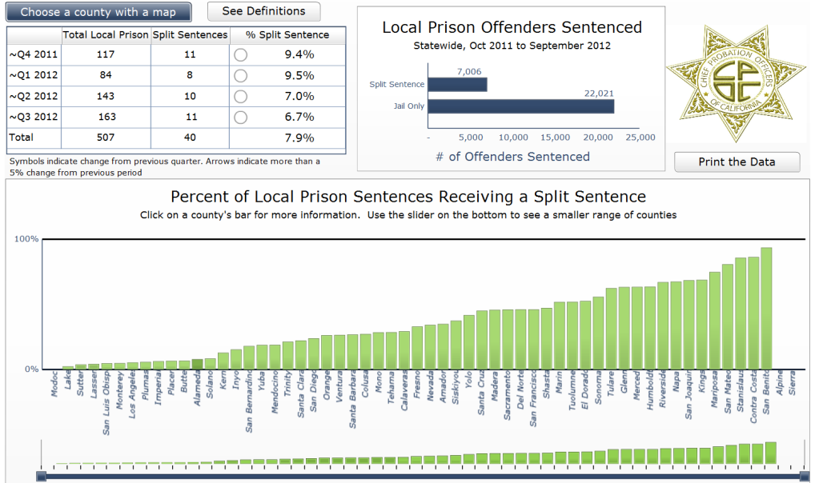
Where to go for data
www.cpoc.org
Presentation Materials

Slide 16
County Panels
Supervision and Collaboration
Evidence Based Practices and Treatment
Sentencing

Slide 17
Supervision and Collaboration
Chief Linda Penner, Fresno
Chief Michelle Scray Brown, San Bernardino
Chief Robert Ochs, Sonoma

Slide 18
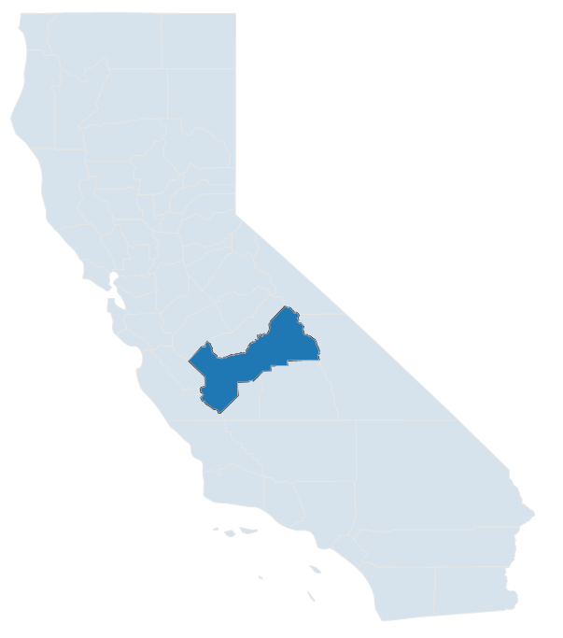
Fresno County
Felony Probation:
8,711
Active PRCS:
1,304
Local Prison Terms:
902
Split Sentence %:
33%

Slide 19
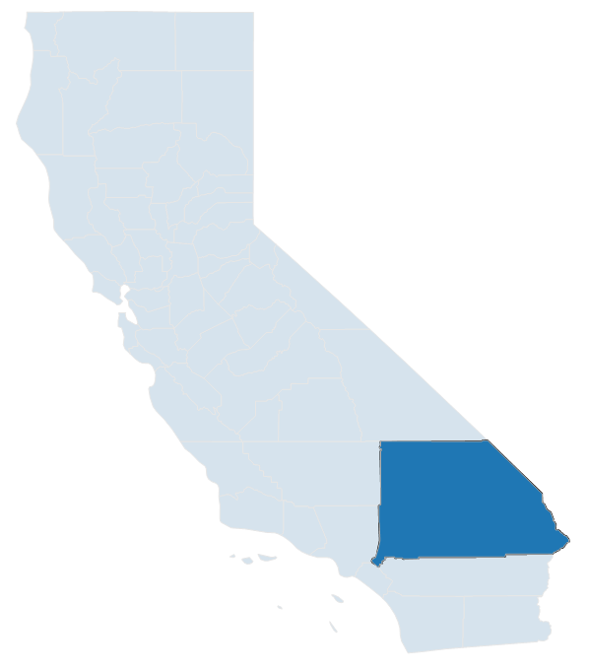
San Bernardino County
Felony Probation:
19,540
Active PRCS:
3,380
Local Prison Terms:
3,471
Split Sentence %:
18%

Slide 20
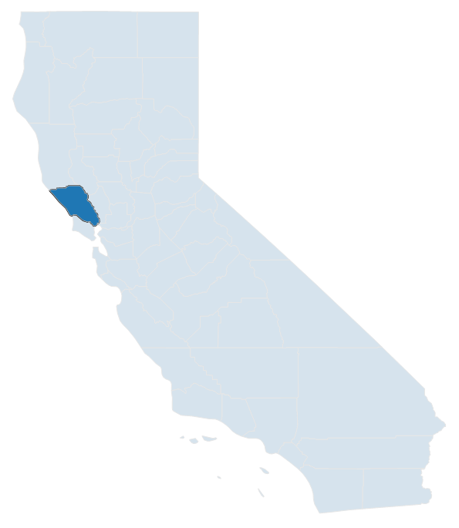
Sonoma County
Felony Probation:
2,270
Active PRCS:
229
Local Prison Terms:
186
Split Sentence %:
56%

Slide 21
Evidence Based Practices and Treatment
Chief Steve Bordin, Butte
Chief Michael Daly, Marin
Chief Mack Jenkins, San Diego

Slide 22
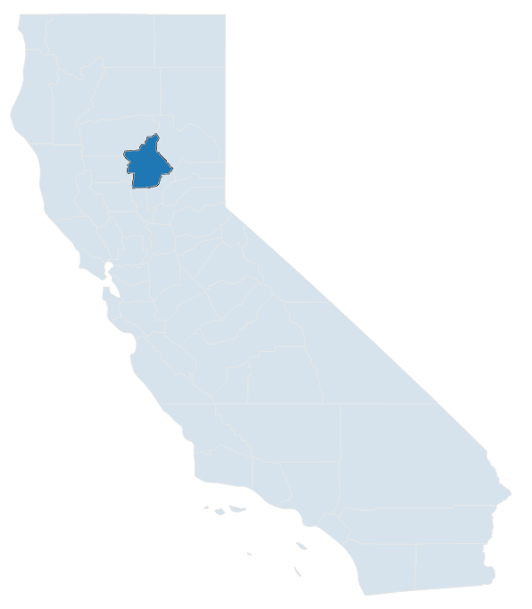
Butte County
Felony Probation:
1,442
Active PRCS:
277
Local Prison Terms:
310
Split Sentence %:
7%

Slide 23
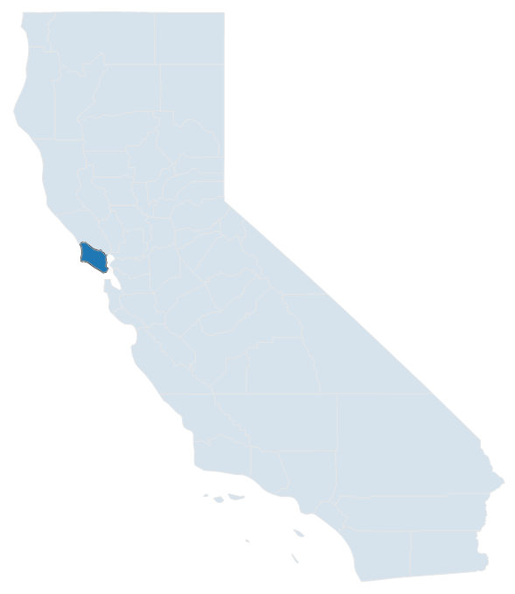
Marin County
Felony Probation:
1,304
Active PRCS:
43
Local Prison Terms:
25
Split Sentence %:
52%

Slide 24
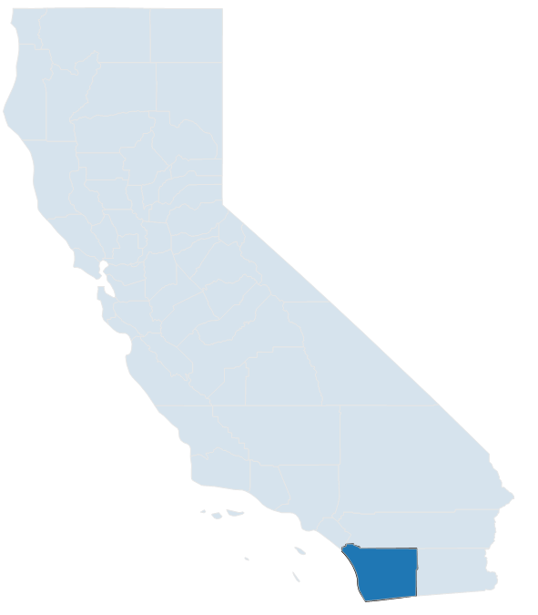
San Diego County
Felony Probation:
16,531
Active PRCS:
2,082
Local Prison Terms:
1,399
Split Sentence %:
24%

Slide 25
Sentencing
Chief Jill Silva, Stanislaus
Chief Philip Kader, Contra Costa
Chief Mary Butler, Napa

Slide 26
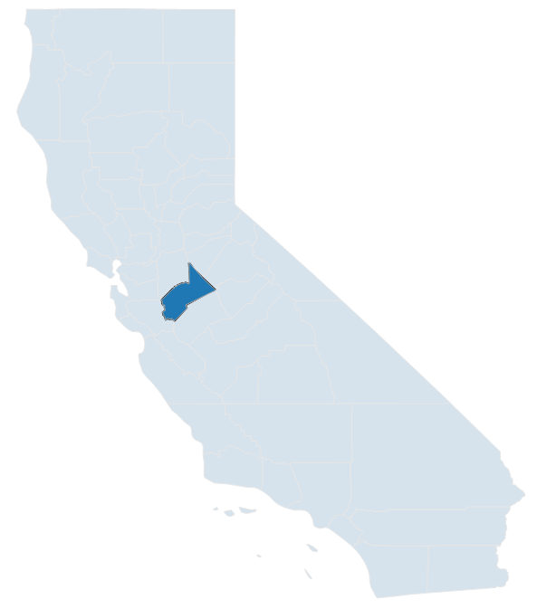
Stanislaus County
Felony Probation:
5,826
Active PRCS:
620
Local Prison Terms:
506
Split Sentence %:
86%

Slide 27
Contra Costa County
Felony Probation:
3,451
Active PRCS:
239
Local Prison Terms:
199
Split Sentence %:
86%

Slide 28
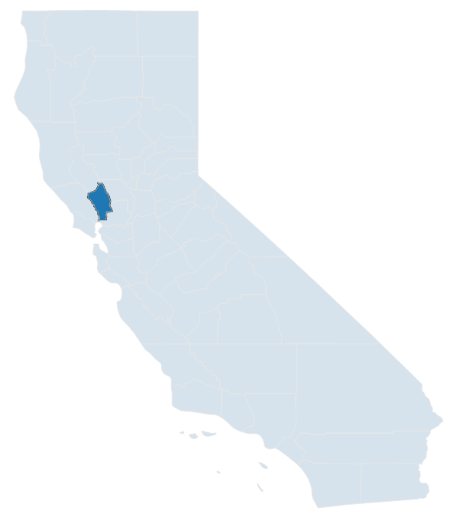
Napa County
Felony Probation:
1,261
Active PRCS:
63
Local Prison Terms:
68
Split Sentence %:
68%

