Slide 1

County of San Diego
Implementing Evidence Based Principles into Supervision
March 20,2013
Mack Jenkins, Chief Probation Officer County of San Diego
Notes:
1

Slide 2
Evidence-Based Practice
Strategic Initiatives
Use Assessment Tools to assess actuarial risks and needs
Match Supervision to Risk Level
Create Individualized Case Plans
Incorporate into Sentencing Recommendations
Employ Incentives and Sanctions Continuum
Educate Stakeholders
Improve Officer Skills
Manage/Reduce Detention Population
Use Screen Tools for Diversion Strategies
Explore Detention Alternatives

Slide 3
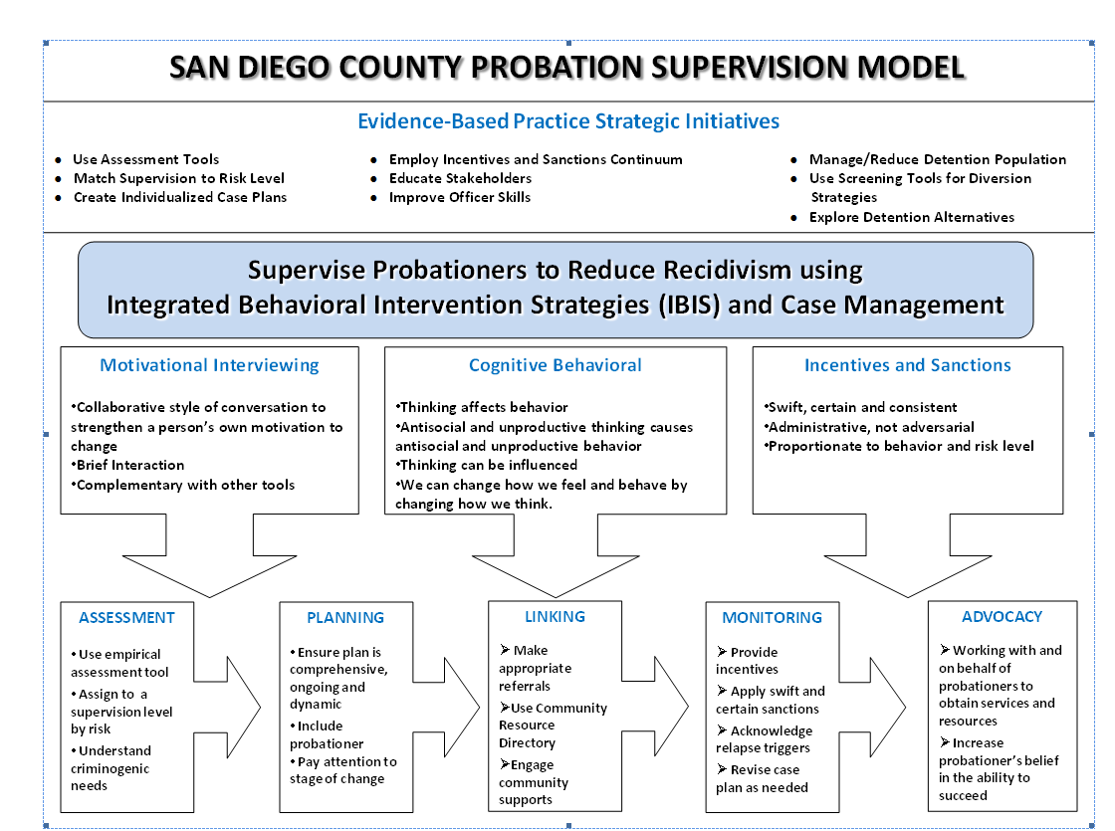
Evidence-Based Practice
Supervision Model

Slide 4
Incorporating Evidence-Based Practices
Use of COMPAS risk/needs assessment to guide service procurement for population’s rehabilitation needs
Expanded contracts with HHSA for mental health and substance abuse services
    Alcohol & Drug Treatment : 6 outpatient & 10 residential
    Mental Health Treatment : 6 outpatient & 1 full service partnership

Slide 5

Community Transition Center
(CTC)
Notes:
5

Slide 6
Community Transition Center (CTC)
Offenders are picked up from prison and transported to the CTC on the day of release
Criminogenic needs are assessed
Physical and behavioral health issues are identified
Individuals are linked to needed services
Medi-Cal/Low Income Health Program enrollment assistance available
Short-term transitional housing is available for up to 7 days

Slide 7
Mandatory Supervision Offenders
Supervision Plan
Notes:
7

Slide 8
MSO Supervision Plan Goals
To Develop and Implement Evidence Based Supervision and Treatment Practices to Reduce Recidivism to Protect Community Safety
Thoroughly Assess Offenders in Order to Determine Criminogenic Risks and Needs
Develop a Living Case Plan that will Adapt as the Offender Progresses from In-Custody into the Community
Provide In-Custody Treatment to Address the Identified Risks and Needs
Create a Seamless Transition form Custody to the Community

Slide 9
Mandatory Supervision Offenders
Supervision Plan
Leveraging Collaborative Justice Principles:
  Pre-Sentence Assessment and Case Planning
  In-Custody Reentry Services
  Pre-release Court Hearing
  Proactive Supervision in the Community
  Regular Status Hearings with the Court
  Incentive Based Supervision Step-Down
  Promotion of Self-Sufficiency & Aftercare

Slide 10
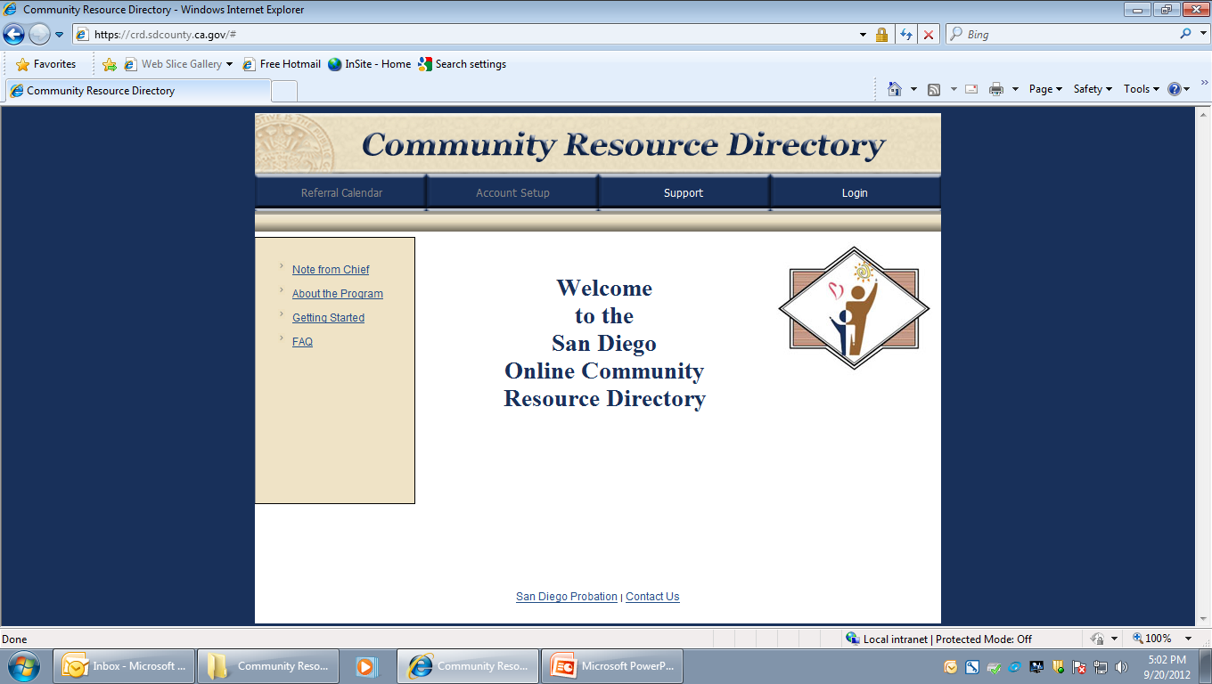
Community Resource Directory (CRD)
Notes:
10

Slide 11
Community Resource Directory
Online referrals to community services based on assessed risk and highest criminogenic needs according to evidence based principles:
  Supports probation officer’s role as a case manager
  Assists in the delivery of services to offenders in pursuit of rehabilitation
  Allows for measurement of offender participation and progress in treatment

Slide 12
Appendix
Notes:
12

Slide 13
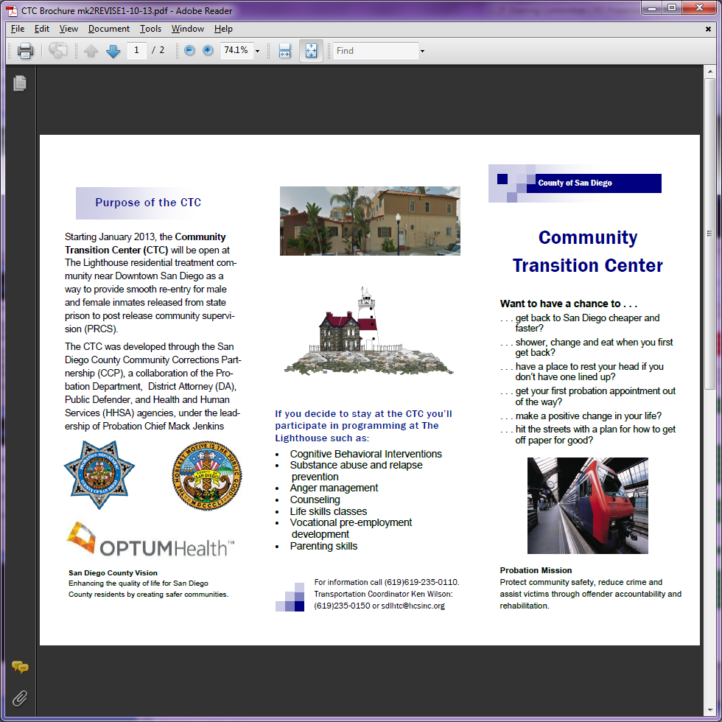
CTC Brochure

Slide 14
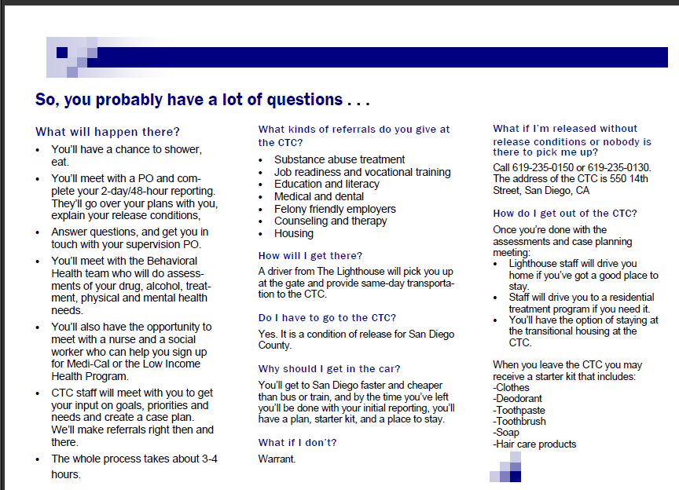
CTC Brochure

Slide 15

CRD Fact Sheet

Slide 16
AB109:
Our First Year Experience
State Estimates (Department of Finance)
2,000 Post Release Offenders (PROs) Upon Full Implementation
Average Daily Population Increase to 2,100 Over 2 Year Implementation
San Diego County Actual (as of October 1,2012)
2,736 PROs Released in the First Year of Realignment
1,596 Realigned Offenders Incarcerated on October 1, 2012
1,821 1170 (h) Sentences Over 2 Year Implementation
1,814 1170(h) Sentences in the First Year of Realignment

Slide 17
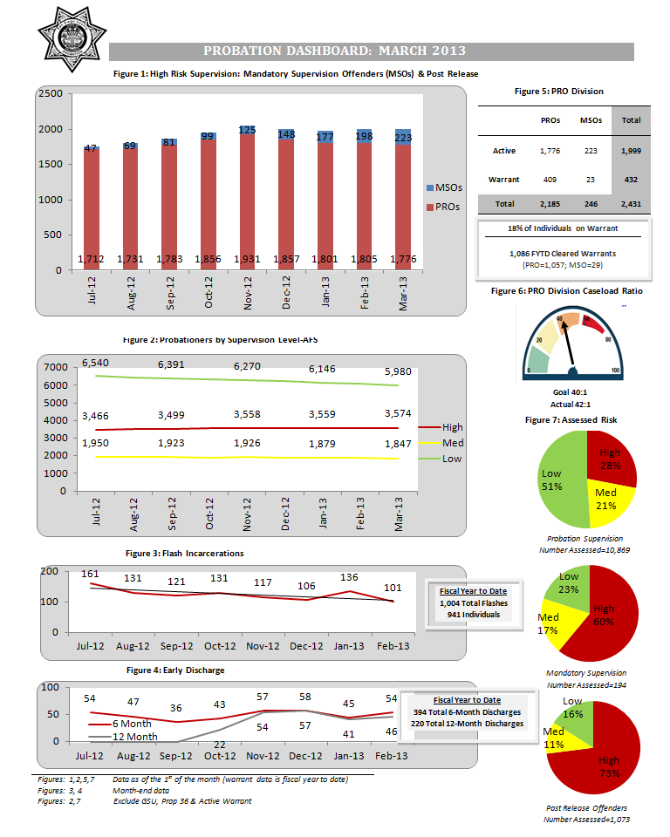
Fiscal Year To Date

Slide 18
County of San Diego
Implementing Evidence Based Principles into Supervision
March 20,2013
Mack Jenkins, Chief Probation Officer County of San Diego
Notes:
18

